Slide 1
Intelligent Hand-eye Expert
RVC Series
3D Area Scanner
RVC-P series
www.rvbust.com

Slide 2
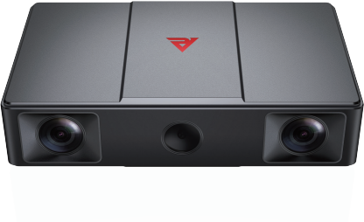
Professional 3D area scanner built for craftsmanship
Intelligent Hand-eye Expert
RVC-P3270
High Precision
3D Area Scanner
RVC-P3270 high-precision 3D area scanner, single-point repeatability of up to 0.012mm, with built-in self-developed 3D imaging algorithms, make it resistance to ambient light excellently and operate more stable. The scanner can be widely used in 3C digital, home appliances, automotive parts production process, such as positional, gap, surface difference inspection scenarios.
Aircraft aluminum fuselage for all-around protection
Waterproof level greatly improved
Dust proof level greatly improved
Passed professional vibration test
Gigabit Ethernet port data transfer
Integrated Body
stable and solid
Fan-free heat dissipation Design
Weight loss, noise reduction, smaller volume
Equipped with high-resolution lens
Highlighted 3D Module
Stabilization of light output to achieve a stable and reliable scanning
High environmental resistance
performance fuselage
Reduce the image noise of point cloud
Aviation aluminum alloy shell
IP 65 level protection
www.rvbust.com
400 - 0419 - 900
sales@rvbust.com

Slide 3
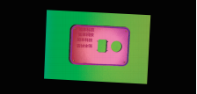
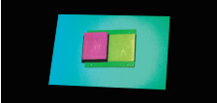
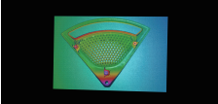
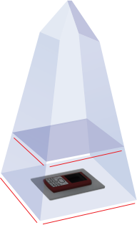
Professional 3D area scanner built for craftsmanship
Intelligent Hand-eye Expert
Core Advantages
Ultra-high precision
Self-developed machine vision high accuracy calibration algorithm, single point repeatability up to 0.012mm.
Stable and reliable
IP65 rated and tested for stable operation in harsh environments.
Anti ambient light
Self-developed dynamic streak structured light technology, exce-llent imaging effect on bright work-pieces.
Point cloud display
glue ring inspection of structural parts
point cloud
Scratch detection of metal parts
point cloud
notch inspection of structural components
point cloud
Product reference data
model | RVC-P3270
Minimum shooting time (sec / frame) | 1.43
Resolution (MP) | 3.2 binocular
Operating distance range (mm) | 250~350
Near field of view (FOV) (mm) | 220*135 @ 250
Far field of view (FOV) (mm) | 289*186 @ 350
XY directional resolution (mm) | 0.11~0.15
Z-axis single-point repetition accuracy (mm) | 0.012~0.020
Repeat accuracy of the Z-axis region (mm) | 0.0004~0.0012
illuminant source | RGB LED
Communication interface | Gigabit Ethernet
scanner weight (kg) | 1.6
scanner size (mm) | 250*135*57
Operating voltage / current | DC 24V/3.75A
Levels of protection | IP65
Operating temperature (°C) | 0~45
Operating Humidity (% RH) | 20~80 (no condensation)
Standard fitting | power supply adapter, power supply cord, data cable
Whether the third-party development is supported | yes
Supported development language | C/C++/C#/Python
Supported development platform | Linux/Windows
Adapt to the third-party software library | Halcon/OpenCV/Open3D/PCL/VisionPro
250mm
350mm
135mm
220mm
186mm
289mm
www.rvbust.com
400 - 0419 - 900
sales@rvbust.com

Slide 4
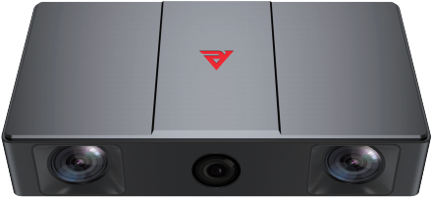
Professional 3D area scanner built for craftsmanship
Intelligent Hand-eye Expert
RVC-P5330
High Precision
3D Area Scanner
RVC-P5330 high-precision 3D area scanner is suitable for assembling, gluing, grinding, welding and other high-precision visual positioning guidance scenes, also used for detecting surface defects, structural dimen-sions and other high-precision inspection. It can output high-precision point clouds of all kinds of complex workpieces, metals, plastics and other typical objects, to meet the needs of most industrial applications.
Aircraft aluminum fuselage for all-around protection
Waterproof level greatly improved
Dust proof level greatly improved
Passed professional vibration test
Gigabit Ethernet port data transfer
Integrated Body
stable and solid
Fan-free heat dissipation Design
Weight loss, noise reduction, smaller volume
Equipped with high-resolution lens
Highlighted 3D Module
Stabilization of light output to achieve a stable and reliable scanning
High environmental resistance
performance fuselage
Reduce the image noise of point cloud
Aviation aluminum alloy shell
IP 65 level protection
www.rvbust.com
400 - 0419 - 900
sales@rvbust.com

Slide 5
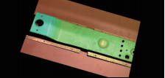
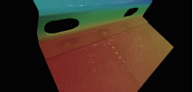
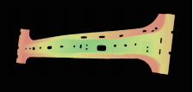
Professional 3D area scanner built for craftsmanship
Intelligent Hand-eye Expert
Core Advantages
Ultra-high precision
Equipped with a 5-megapixel binocular lens, the single-point repeatability can be up to 0.025mm, which meets the customer's demand for high-resolution screen output such as X, Y direction measurement or positioning.
Anti ambient light
The self-developed dynamic stripe structured Light technology can detect a variety of materials at the same time, which greatly improves the ability to resist interference from ambient light and creates a more complete image.
Point cloud display
Sheet metal parts gluing inspection point cloud
steel plate workpiece point cloud
Automobile B-pillar workpiece point cloud
Product reference data
model | RVC-P5330
Minimum shooting time (sec / frame) | 3.45
Resolution (MP) | 5.0 binocular
Operating distance range (mm) | 380~580
Near field of view (FOV) (mm) | 263*171@380
Far field of view (FOV) (mm) | 373*252@580
XY directional resolution (mm) | 0.11~0.17
Z-axis single-point repetition accuracy (mm) | 0.025~0.046
Repeat accuracy of the Z-axis region (mm) | 0.0017~0.0044
illuminant source | blue LED
Communication interface | Gigabit Ethernet
scanner weight (kg) | 1.7
scanner size (mm) | 250*135*57
Operating voltage / current | DC 24V/3.75A
Levels of protection | IP65
Operating temperature (°C) | 0~45
Operating Humidity (% RH) | 20~80 (no condensation)
Standard fitting | power supply adapter, power supply cord, data cable
Whether the third-party development is supported | yes
Supported development language | C/C++/C#/Python
Supported development platform | Linux/Windows
Adapt to the third-party software library | Halcon/OpenCV/Open3D/PCL/VisionPro
380mm
580mm
171mm
263mm
252mm
373mm
www.rvbust.com
400 - 0419 - 900
sales@rvbust.com

Slide 6
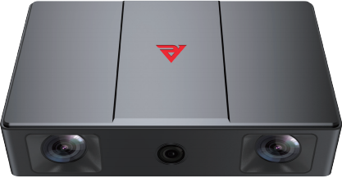
Professional 3D area scanner built for craftsmanship
Intelligent Hand-eye Expert
RVC-P2600
High Precision
3D Area Scanner
RVC-P2600 high-precision 3D area scanner with binocular lens, compact structure design, and stable perfor-mance. RVC-P2600 is waterproof, dustproof, high temperature resistance, adapt to the factories environments full of dust,water vapor, and oil stains. The scanner used widely in welding, cutting, grinding, spraying, positi-oning assembly, gluing and other high-precision visual positioning scenes.
Aircraft aluminum fuselage for all-around protection
Waterproof level greatly improved
Dust proof level greatly improved
Passed professional vibration test
Gigabit Ethernet port data transfer
Integrated Body
stable and solid
Fan-free heat dissipation Design
Weight loss, noise reduction, smaller volume
Equipped with high-resolution lens
Highlighted 3D Module
Stabilization of light output to achieve a stable and reliable scanning
High environmental resistance
performance fuselage
Reduce the image noise of point cloud
Aviation aluminum alloy shell
IP 65 level protection
www.rvbust.com
400 - 0419 - 900
sales@rvbust.com

Slide 7
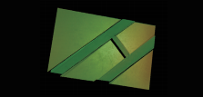
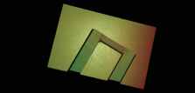
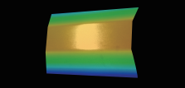
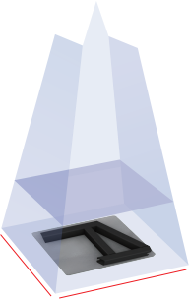
Professional 3D area scanner built for craftsmanship
Intelligent Hand-eye Expert
Core Advantages
high protection
Aircraft aluminum unibody design, IP65 waterproof and dustproof.
Anti ambient light
The self-developed Dynamic Stripe Structured Light technology can detect a variety of materials at the same time, which greatly improves the ability to resist interference from ambient light and creates a more complete image.
Point cloud display
Welded workpiece point cloud
Welded workpiece
point cloud
Large vehicle painting guide
point cloud
Product reference data
model | RVC-P2600
Minimum shooting time (sec / frame) | 1.42
Resolution (MP) | 1.6 binocular
Operating distance range (mm) | 800~1200
Near field of view (FOV) (mm) | 465*308@800
Far field of view (FOV) (mm) | 684*466@1200
XY directional resolution (mm) | 0.35~0.52
Z-axis single-point repetition accuracy (mm) | 0.106~0.348
Repeat accuracy of the Z-axis region (mm) | 0.010~0.026
illuminant source | RGB LED
Communication interface | Gigabit Ethernet
scanner weight (kg) | 1.7
scanner size (mm) | 220*135*57
Operating voltage / current | DC 24V/3.75A
Levels of protection | IP65
Operating temperature (°C) | 0~45
Operating Humidity (% RH) | 20~80 (no condensation)
Standard fitting | power supply adapter, power supply cord, data cable
Whether the third-party development is supported | yes
Supported development language | C/C++/C#/Python
Supported development platform | Linux/Windows
Adapt to the third-party software library | Halcon/OpenCV/Open3D/PCL/VisionPro
800mm
1200mm
308mm
465mm
466mm
684mm
www.rvbust.com
400 - 0419 - 900
sales@rvbust.com

Slide 8
Professional 3D area scanner built for craftsmanship
Intelligent Hand-eye Expert
RVC-P31300&P32200
Medium Large View
3D Area Scanner
RVC-P31300&P32200 medium and large field of view 3D industrial cameras, with large field of view, high preci-sion, fast imaging speed and excellent resistance to ambient light, can take photos of a large number of com-plex structure, tightly stacked, disorderly placement of various types of objects and output high-quality 3D point cloud datas to guide the robot to complete the disorderly grasping, material sorting, loading and unload-ing, depalletizing, spraying of various types of all sizes workpieces. which is widely used in various fields such as automotive manufacturing, logistics, packaging, electronics, heavy machinery, food and home appliances.
Aircraft aluminum fuselage for all-around protection
Waterproof level greatly improved
Dust proof level greatly improved
Passed professional vibration test
Gigabit Ethernet port data transfer
Integrated Body
stable and solid
Fan-free heat dissipation Design
Weight loss, noise reduction, smaller volume
Highlighted 3D Module
Stabilization of light output to achieve a stable and reliable scanning
High environmental resistance
performance fuselage
Equipped with high-resolution lens
Aviation aluminum alloy shell
Reduce the image noise of point cloud
IP 65 level protection
www.rvbust.com
400 - 0419 - 900
sales@rvbust.com

Slide 9
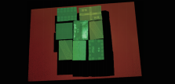
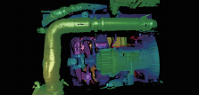
Professional 3D area scanner built for craftsmanship
Intelligent Hand-eye Expert
Core Advantages
Higher precision
The single-point repeatability of up to 0.1mm realizes high-precision shooting with a large field of view and a long distance, making it easy to deal with a wide range of workpieces with complex structures and tightly stacked workpieces.
Anti ambient light
The self-developed Dynamic Stripe Structured Light technology can detect a variety of materials at the same time, which greatly improves the ability to resist interference from ambient light and creates a more complete image.
Multi-version selection
Provide blue/white light options to meet customers' multi-scene needs.
Greater Vision
2.5*1.6 @ 3.3 meters large field of view, 1.3 meters large depth of field, easy to cover a variety of application scenarios.
Point cloud display
Various carton
point cloud
Depalletizing of soft packages
point cloud
Automotive chassis components
point cloud
RVC-P32200
3D area scanner
Product reference data
model | RVC-P32200 | RVC-P31300
Minimum shooting time (sec / frame) | 2.6 | 1.43
Resolution (MP) | 3.2 binocular | 3.2 binocular
Operating distance range (mm) | 2000~3300 | 1200~2000
Near field of view (FOV) (mm) | 1589*1040@2000 | 1010*636@1200
Far field of view (FOV) (mm) | 2556*1667@3300 | 1551*1012@2000
XY directional resolution (mm) | 0.85~1.5 | 0.5~0.7
Z-axis single-point repetition accuracy (mm) | 0.22~0.77 | 0.10~0.46
Repeat accuracy of the Z-axis region (mm) | 0.004~0.03 | 0.008~0.019
illuminant source | 4.0 | 2.6
Communication interface | 760*135*58 | 560*135*58
scanner weight (kg) | RGB LED
scanner size (mm) | Gigabit Ethernet
Operating voltage / current | DC 24V/3.75A
Levels of protection | IP65
Operating temperature (°C) | 0~45
Operating Humidity (% RH) | 20~80 (no condensation)
Standard fitting | power supply adapter, power supply cord, data cable
Whether the third-party development is supported | yes
Supported development language | C/C++/C#/Python
Supported development platform | Linux/Windows
Adapt to the third-party software library | Halcon/OpenCV/Open3D/PCL/VisionPro
RVC-P31300
3D area scanner
2000mm
3300mm
1200mm
1040mm
1589mm
2000mm
636mm
1010mm
1667mm
2556mm
1012mm
1551mm
www.rvbust.com
400 - 0419 - 900
sales@rvbust.com

